Slide 1

Summoners War: Sky Arena - Ticketing System
PLAY
SETTINGS
SUPPORT

Slide 2
Sign Up
User Login
FAQ
Back

Slide 3
Question:
Answer:
Question:
Answer:
Question:
Answer:
Question:
Answer:
Question:
Answer:
Question:
Answer:
Back

Slide 4
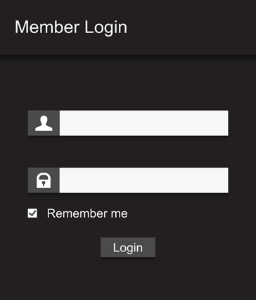
User Login
username@gmail.com
••••••••
Admin Login
Back

Slide 5
Admin Login
Admin@gmail.com
••••••••
User Login
Back

Slide 6
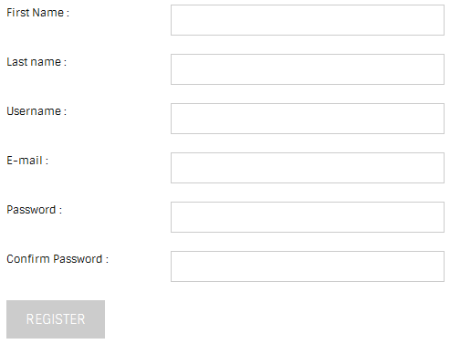
Registration Form
User
Name
username
username@gmail.com
**********
**********
REGISTER
Back

Slide 7
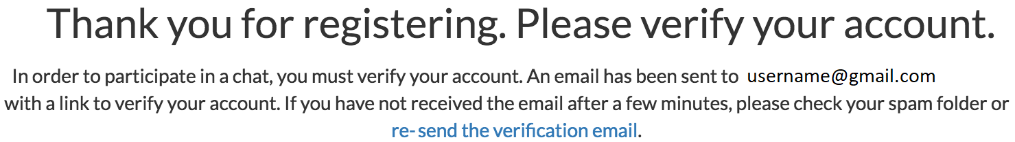
Check your account

Slide 8
Report a problem
View previous tickets
Back

Slide 9
Describe your issue
I Can’t Log In
Account Support
Reason
Help Creating an Account
My problem is not listed here…
Description of Issue
Submit

Slide 10
Describe your issue
I Can’t Log In
Reason
Help Creating an Account
Description of Issue
Submit

Slide 11
Describe your issue
I Can’t Log In
Reason
Help Creating an Account
Description of Issue
Submit

Slide 12
Describe your issue
Account Support
Reason
Upgrade Game Account
Description of Issue
Submit

Slide 13
Describe your issue
Account Support
Reason
Upgrade Game Account
Description of Issue
Submit

Slide 14
Search Code:
00000
Status | Description | Code | Date
in process | Can’t Login | 10312 | 18-5-2017
Done | Forgot password | 10267 | 23-04-2016
in process | Unable to save the game | 10229 | 12-11-2015
Done | ##### | 10173 | 27-2-2015
Done | ##### | 10156 | 23-9-2014
Done | Forgot password | 10098 | 06-03-2014
Done | ##### | 10065 | 02-01-2014
Back

Slide 15
Search Code:
00000
Status | Description | Code | Date
Done | ##### | 10065 | 02-01-2014
Done | Forgot password | 10098 | 06-03-2014
Done | ##### | 10156 | 23-9-2014
Done | ##### | 10173 | 27-2-2015
in process | Unable to save the game | 10229 | 12-11-2015
Done | Forgot password | 10267 | 23-04-2016
in process | Can’t Login | 10312 | 18-5-2017
Back

Slide 16
Admin Center
previous Case | New Case
Forgot password | Can’t Login
##### | Unable to save the game
#####
Forgot password
#####
Back

Slide 17
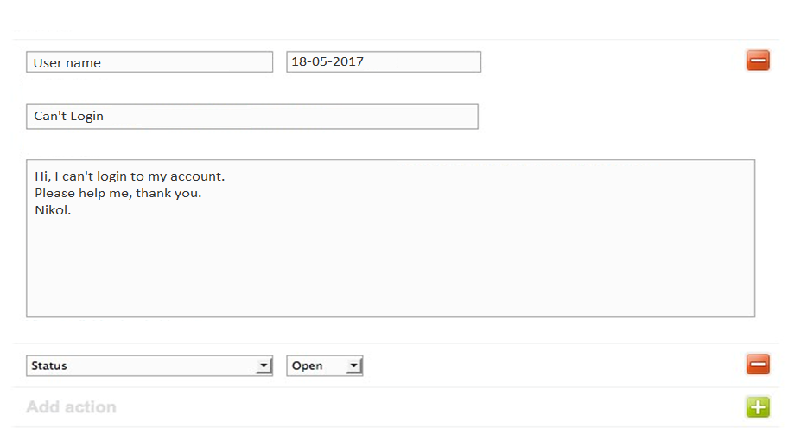
Admin Center
Create New Ticket
Choose Department
Submit
Back

Slide 18
Admin Center
Create New Ticket
In process
Choose Department
Submit
Done
Back

Slide 19
Admin Center
Create New Ticket
In process
Choose Department
Submit
Back

Slide 20
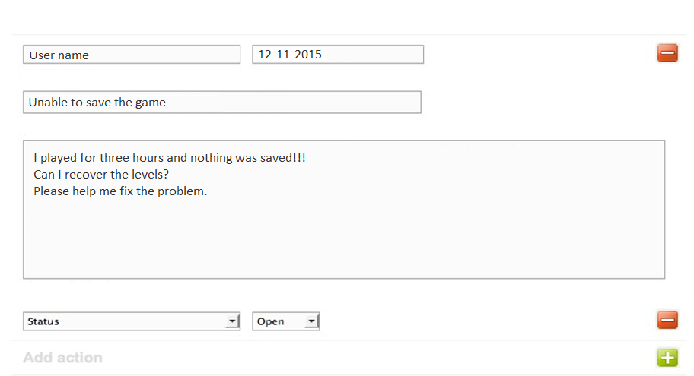
Admin Center
Create New Ticket
Choose Department
Submit
Back

Slide 21
Admin Center
Create New Ticket
In process
Choose Department
Submit
Done
Back

Slide 22
Admin Center
Create New Ticket
In process
Choose Department
Submit
Back

Slide 23
Admin Center
# A new ticket was create – return to Case List

Slide 24
System has received your request, Thank you.
For More Actions

